Slide 1
Loops
Lecture No 3

Slide 2
What You Will Learn . . .
Switch Case
Loops
  While
  Do-while
  For

Slide 3
Switch Case
The switch-case is another conditional structure that may or may not execute certain statements. However, the switch-case has peculiar syntax and behavior:

Slide 4
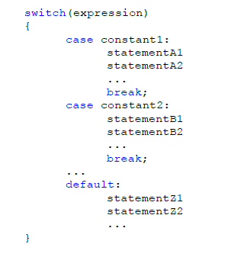
Switch Case

Slide 5
Switch Case
The switch evaluates expression and, if expression is equal to constant1, then the statements beneath case constant 1: are executed until a break is encountered.
If expression is not equal to constant1, then it is compared to constant2. If these are equal, then the statements beneath case constant 2: are executed until a break is encountered.
If not, then the same process repeats for each of the constants, in turn.
If none of the constants match, then the statements beneath default: are executed.

Slide 6
Switch Case
Due to the peculiar behavior of switch-cases, curly braces are not necessary for cases where there is more than one statement (but they are necessary to enclose the entire switch-case).
Switch-cases generally have if-else equivalents but can often be a cleaner way of expressing the same behavior.

Slide 7
Switch Case
#include <iostream>
using namespace std;
int main() {
char o;
float num1,num2;
cout<<"Select an operator either + or - or * or / \n";
cin>>o;
cout<<"Enter two operands: ";
cin>>num1>>num2;
switch(o) {
case '+':
cout<<num1<<" + "<<num2<<" = "<<num1+num2;
break;
case '-':
cout<<num1<<" - "<<num2<<" = "<<num1-num2;
break;
case '*':
cout<<num1<<" * "<<num2<<" = "<<num1*num2;
break;
case '/':
cout<<num1<<" / "<<num2<<" = "<<num1/num2;
break;
default:
/* If operator is other than +, -, * or /, error message is shown */
printf("Error! operator is not correct");
break;
}
return 0;
}

Slide 8
Loops
Conditionals execute certain statements if certain conditions are met; loops execute certain statements while certain conditions are met.
C++ has three kinds of loops:
  while,
  do-while, and
  for

Slide 9
Loops
In computer programming, loop cause a certain piece of program to be executed a certain number of times. Consider these scenarios:
You want to execute some code/s certain number of time.
You want to execute some code/s certain number of times depending upon input from user.
These types of task can be solved in programming using loops.

Slide 10
Loops – While
while ( condition )
{
statement(s)
}
The braces are not required if the loop body contains only
a single statement. However, they are a good idea and are
required by the 104 C Coding Standards.

Slide 11
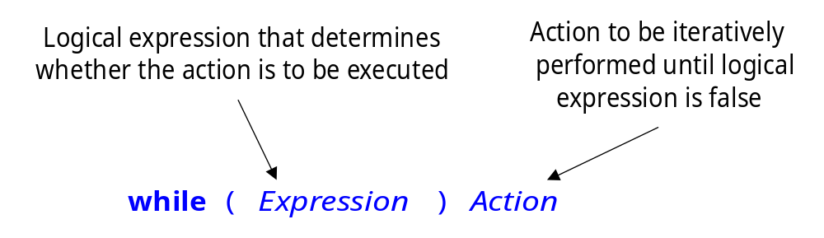
While Syntax

Slide 12
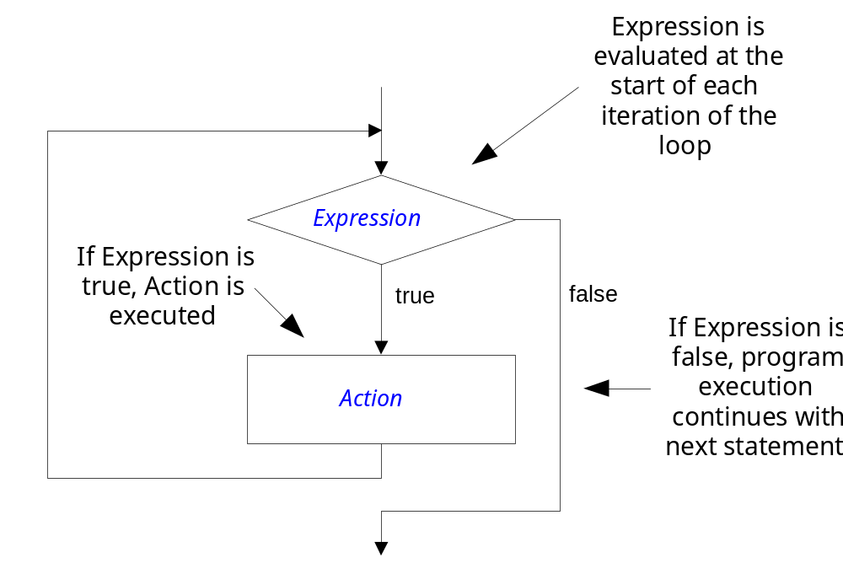
While Semantics

Slide 13
Loops – While
while ( Books > 0 )
{
books = books - 1 ;
cookies = cookies * 2 ;
}

Slide 14
Good Programming Practice
Always place braces around the body of a while loop.
Advantages:
  Easier to read
  Will not forget to add the braces if you go back and add a second statement to the loop body
  Less likely to make a semantic error
Indent the body of a while loop 3 to 5 spaces -- be consistent!

Slide 15
Another while Loop Example
Problem: Write a program that calculates the average exam grade for a class of 10 students.
What are the program inputs?
  the exam grades
What are the program outputs?
  the average exam grade

Slide 16
The C Code
#include <stdio.h>
int main ( )
{
int counter, grade, total, average ;
total = 0 ;
counter = 1 ;
while ( counter <= 10 )
{
printf (“Enter a grade : “) ;
scanf (“%d”, &grade) ;
total = total + grade ;
counter = counter + 1 ;
}
average = total / 10 ;
printf (“Class average is: %d\n”, average) ;
return 0 ;
}

Slide 17
Execution Trace
Suppose input contains: 1 5 3 1 6
listSize
4
int listSize = 4;
int numberProcessed = 0;
double sum = 0;
while (numberProcessed < listSize) {
double value;
cin >> value;
sum += value;
++numberProcessed;
}
double average = sum / numberProcessed ;
cout << "Average: " << average << endl;

Slide 18
Execution Trace
Suppose input contains: 1 5 3 1 6
listSize
4
numberProcessed
0
int listSize = 4;
int numberProcessed = 0;
double sum = 0;
while (numberProcessed < listSize) {
double value;
cin >> value;
sum += value;
++numberProcessed;
}
double average = sum / numberProcessed ;
cout << "Average: " << average << endl;

Slide 19
Execution Trace
Suppose input contains: 1 5 3 1 6
listSize
4
numberProcessed
0
int listSize = 4;
int numberProcessed = 0;
double sum = 0;
while (numberProcessed < listSize) {
double value;
cin >> value;
sum += value;
++numberProcessed;
}
double average = sum / numberProcessed ;
cout << "Average: " << average << endl;
sum
0

Slide 20
Execution Trace
Suppose input contains: 1 5 3 1 6
listSize
4
numberProcessed
0
int listSize = 4;
int numberProcessed = 0;
double sum = 0;
while (numberProcessed < listSize) {
double value;
cin >> value;
sum += value;
++numberProcessed;
}
double average = sum / numberProcessed ;
cout << "Average: " << average << endl;
sum
0

Slide 21
Execution Trace
Suppose input contains: 1 5 3 1 6
listSize
4
numberProcessed
0
int listSize = 4;
int numberProcessed = 0;
double sum = 0;
while (numberProcessed < listSize) {
double value;
cin >> value;
sum += value;
++numberProcessed;
}
double average = sum / numberProcessed ;
cout << "Average: " << average << endl;
sum
0
value
--

Slide 22
Execution Trace
Suppose input contains: 1 5 3 1 6
listSize
4
numberProcessed
0
int listSize = 4;
int numberProcessed = 0;
double sum = 0;
while (numberProcessed < listSize) {
double value;
cin >> value;
sum += value;
++numberProcessed;
}
double average = sum / numberProcessed ;
cout << "Average: " << average << endl;
sum
0
value
1

Slide 23
Execution Trace
Suppose input contains: 1 5 3 1 6
listSize
4
numberProcessed
0
int listSize = 4;
int numberProcessed = 0;
double sum = 0;
while (numberProcessed < listSize) {
double value;
cin >> value;
sum += value;
++numberProcessed;
}
double average = sum / numberProcessed ;
cout << "Average: " << average << endl;
sum
0
1
value
1

Slide 24
Execution Trace
Suppose input contains: 1 5 3 1 6
listSize
4
numberProcessed
0
1
int listSize = 4;
int numberProcessed = 0;
double sum = 0;
while (numberProcessed < listSize) {
double value;
cin >> value;
sum += value;
++numberProcessed;
}
double average = sum / numberProcessed ;
cout << "Average: " << average << endl;
sum
1
value
1

Slide 25
Execution Trace
Suppose input contains: 1 5 3 1 6
listSize
4
numberProcessed
1
int listSize = 4;
int numberProcessed = 0;
double sum = 0;
while (numberProcessed < listSize) {
double value;
cin >> value;
sum += value;
++numberProcessed;
}
double average = sum / numberProcessed ;
cout << "Average: " << average << endl;
sum
1
value
1

Slide 26
Execution Trace
Suppose input contains: 1 5 3 1 6
listSize
4
numberProcessed
1
int listSize = 4;
int numberProcessed = 0;
double sum = 0;
while (numberProcessed < listSize) {
double value;
cin >> value;
sum += value;
++numberProcessed;
}
double average = sum / numberProcessed ;
cout << "Average: " << average << endl;
sum
1
value
--

Slide 27
Execution Trace
Suppose input contains: 1 5 3 1 6
listSize
4
numberProcessed
1
int listSize = 4;
int numberProcessed = 0;
double sum = 0;
while (numberProcessed < listSize) {
double value;
cin >> value;
sum += value;
++numberProcessed;
}
double average = sum / numberProcessed ;
cout << "Average: " << average << endl;
sum
1
value
5

Slide 28
Execution Trace
Suppose input contains: 1 5 3 1 6
listSize
4
numberProcessed
1
int listSize = 4;
int numberProcessed = 0;
double sum = 0;
while (numberProcessed < listSize) {
double value;
cin >> value;
sum += value;
++numberProcessed;
}
double average = sum / numberProcessed ;
cout << "Average: " << average << endl;
sum
1
6
value
5

Slide 29
Execution Trace
Suppose input contains: 1 5 3 1 6
listSize
4
numberProcessed
1
2
int listSize = 4;
int numberProcessed = 0;
double sum = 0;
while (numberProcessed < listSize) {
double value;
cin >> value;
sum += value;
++numberProcessed;
}
double average = sum / numberProcessed ;
cout << "Average: " << average << endl;
sum
6
value
5

Slide 30
Execution Trace
Suppose input contains: 1 5 3 1 6
listSize
4
numberProcessed
2
int listSize = 4;
int numberProcessed = 0;
double sum = 0;
while (numberProcessed < listSize) {
double value;
cin >> value;
sum += value;
++numberProcessed;
}
double average = sum / numberProcessed ;
cout << "Average: " << average << endl;
sum
6
6
value
5

Slide 31
Execution Trace
Suppose input contains: 1 5 3 1 6
listSize
4
numberProcessed
2
2
int listSize = 4;
int numberProcessed = 0;
double sum = 0;
while (numberProcessed < listSize) {
double value;
cin >> value;
sum += value;
++numberProcessed;
}
double average = sum / numberProcessed ;
cout << "Average: " << average << endl;
sum
6
value
--

Slide 32
Execution Trace
Suppose input contains: 1 5 3 1 6
listSize
4
numberProcessed
2
2
int listSize = 4;
int numberProcessed = 0;
double sum = 0;
while (numberProcessed < listSize) {
double value;
cin >> value;
sum += value;
++numberProcessed;
}
double average = sum / numberProcessed ;
cout << "Average: " << average << endl;
sum
6
value
3

Slide 33
Execution Trace
Suppose input contains: 1 5 3 1 6
listSize
4
numberProcessed
2
int listSize = 4;
int numberProcessed = 0;
double sum = 0;
while (numberProcessed < listSize) {
double value;
cin >> value;
sum += value;
++numberProcessed;
}
double average = sum / numberProcessed ;
cout << "Average: " << average << endl;
sum
6
9
value
3

Slide 34
Execution Trace
Suppose input contains: 1 5 3 1 6
listSize
4
numberProcessed
2
3
int listSize = 4;
int numberProcessed = 0;
double sum = 0;
while (numberProcessed < listSize) {
double value;
cin >> value;
sum += value;
++numberProcessed;
}
double average = sum / numberProcessed ;
cout << "Average: " << average << endl;
sum
9
value
3

Slide 35
Execution Trace
Suppose input contains: 1 5 3 1 6
listSize
4
numberProcessed
3
3
int listSize = 4;
int numberProcessed = 0;
double sum = 0;
while (numberProcessed < listSize) {
double value;
cin >> value;
sum += value;
++numberProcessed;
}
double average = sum / numberProcessed ;
cout << "Average: " << average << endl;
sum
9
value
3

Slide 36
Execution Trace
Suppose input contains: 1 5 3 1 6
listSize
4
numberProcessed
3
3
int listSize = 4;
int numberProcessed = 0;
double sum = 0;
while (numberProcessed < listSize) {
double value;
cin >> value;
sum += value;
++numberProcessed;
}
double average = sum / numberProcessed ;
cout << "Average: " << average << endl;
sum
9
value
--

Slide 37
Execution Trace
Suppose input contains: 1 5 3 1 6
listSize
4
numberProcessed
3
3
int listSize = 4;
int numberProcessed = 0;
double sum = 0;
while (numberProcessed < listSize) {
double value;
cin >> value;
sum += value;
++numberProcessed;
}
double average = sum / numberProcessed ;
cout << "Average: " << average << endl;
sum
9
value
1

Slide 38
Execution Trace
Suppose input contains: 1 5 3 1 6
listSize
4
numberProcessed
3
int listSize = 4;
int numberProcessed = 0;
double sum = 0;
while (numberProcessed < listSize) {
double value;
cin >> value;
sum += value;
++numberProcessed;
}
double average = sum / numberProcessed ;
cout << "Average: " << average << endl;
sum
9
10
value
1

Slide 39
Execution Trace
Suppose input contains: 1 5 3 1 6
listSize
4
numberProcessed
3
4
int listSize = 4;
int numberProcessed = 0;
double sum = 0;
while (numberProcessed < listSize) {
double value;
cin >> value;
sum += value;
++numberProcessed;
}
double average = sum / numberProcessed ;
cout << "Average: " << average << endl;
sum
10
value
1

Slide 40
Execution Trace
Suppose input contains: 1 5 3 1 6
listSize
4
numberProcessed
3
4
int listSize = 4;
int numberProcessed = 0;
double sum = 0;
while (numberProcessed < listSize) {
double value;
cin >> value;
sum += value;
++numberProcessed;
}
double average = sum / numberProcessed ;
cout << "Average: " << average << endl;
sum
10
value
1

Slide 41
Execution Trace
Suppose input contains: 1 5 3 1 6
listSize
4
numberProcessed
3
4
int listSize = 4;
int numberProcessed = 0;
double sum = 0;
while (numberProcessed < listSize) {
double value;
cin >> value;
sum += value;
++numberProcessed;
}
double average = sum / numberProcessed ;
cout << "Average: " << average << endl;
sum
10
average
2.5

Slide 42
Execution Trace
Suppose input contains: 1 5 3 1 6
listSize
4
numberProcessed
3
4
int listSize = 4;
int numberProcessed = 0;
double sum = 0;
while (numberProcessed < listSize) {
double value;
cin >> value;
sum += value;
++numberProcessed;
}
double average = sum / numberProcessed ;
cout << "Average: " << average << endl;
sum
10
average
2.5

Slide 43
The For Statement
Syntax
for (ForInit ; ForExpression; PostExpression)
Action
Example
for (int i = 0; i < 3; ++i) {
cout << "i is " << i << endl;
}

Slide 44
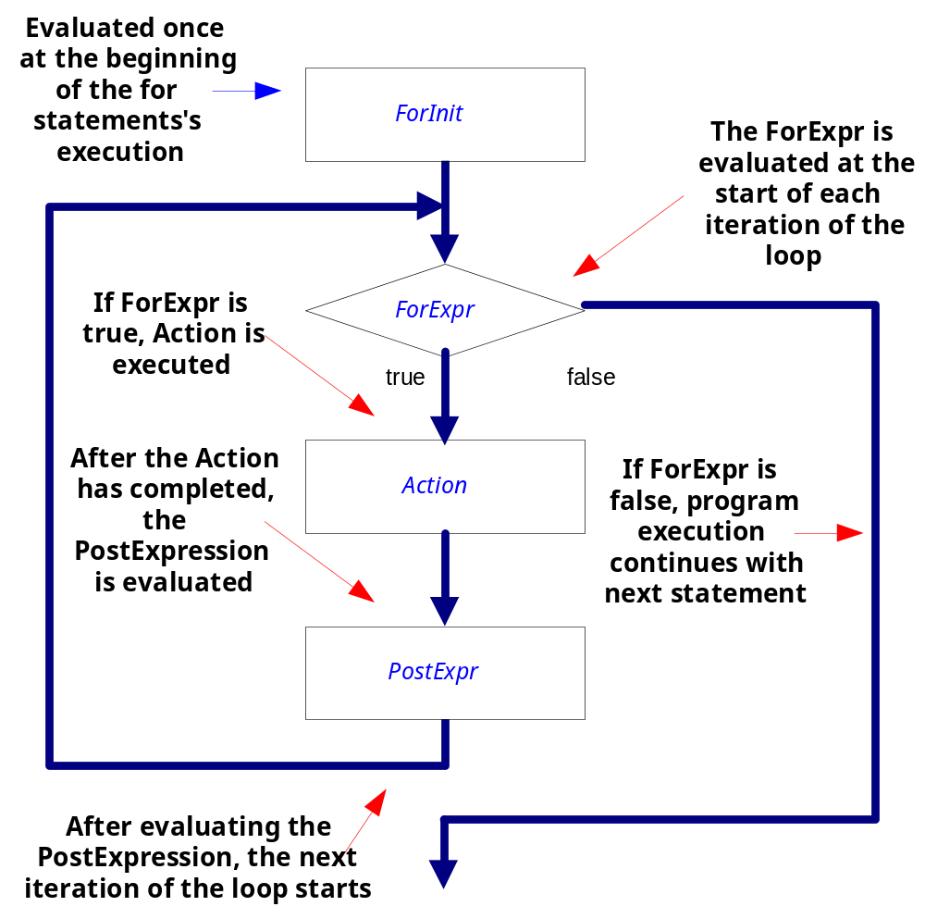

Slide 45
Execution Trace
i
0
for (int i = 0; i < 3; ++i) {
cout << "i is " << i << endl;
}
cout << "all done" << endl;

Slide 46
Execution Trace
i
0
for (int i = 0; i < 3; ++i) {
cout << "i is " << i << endl;
}
cout << "all done" << endl;

Slide 47
Execution Trace
i
0
for (int i = 0; i < 3; ++i) {
cout << "i is " << i << endl;
}
cout << "all done" << endl;
i is 0

Slide 48
Execution Trace
i
0
for (int i = 0; i < 3; ++i) {
cout << "i is " << i << endl;
}
cout << "all done" << endl;
i is 0

Slide 49
Execution Trace
i
1
for (int i = 0; i < 3; ++i) {
cout << "i is " << i << endl;
}
cout << "all done" << endl;
i is 0

Slide 50
Execution Trace
i
1
for (int i = 0; i < 3; ++i) {
cout << "i is " << i << endl;
}
cout << "all done" << endl;

Slide 51
Execution Trace
i
1
for (int i = 0; i < 3; ++i) {
cout << "i is " << i << endl;
}
cout << "all done" << endl;
i is 0
i is 1

Slide 52
Execution Trace
i
1
for (int i = 0; i < 3; ++i) {
cout << "i is " << i << endl;
}
cout << "all done" << endl;
i is 0
i is 1

Slide 53
Execution Trace
i
2
for (int i = 0; i < 3; ++i) {
cout << "i is " << i << endl;
}
cout << "all done" << endl;
i is 0
i is 1

Slide 54
Execution Trace
i
2
for (int i = 0; i < 3; ++i) {
cout << "i is " << i << endl;
}
cout << "all done" << endl;
i is 0
i is 1

Slide 55
Execution Trace
i
2
for (int i = 0; i < 3; ++i) {
cout << "i is " << i << endl;
}
cout << "all done" << endl;
i is 0
i is 1
i is 2

Slide 56
Execution Trace
i
2
for (int i = 0; i < 3; ++i) {
cout << "i is " << i << endl;
}
cout << "all done" << endl;
i is 0
i is 1
i is 2

Slide 57
Execution Trace
i
3
for (int i = 0; i < 3; ++i) {
cout << "i is " << i << endl;
}
cout << "all done" << endl;
i is 0
i is 1
i is 2

Slide 58
Execution Trace
i
3
for (int i = 0; i < 3; ++i) {
cout << "i is " << i << endl;
}
cout << "all done" << endl;
i is 0
i is 1
i is 2

Slide 59
Execution Trace
i
3
for (int i = 0; i < 3; ++i) {
cout << "i is " << i << endl;
}
cout << "all done" << endl;
i is 0
i is 1
i is 2
all done

Slide 60
The Do-While Statement
Syntax
do Action
while (Expression)
Semantics
  Execute Action
  If Expression is true then execute Action again
  Repeat this process until Expression evaluates to false
Action is either a single statement or a group of statements within braces
Action
true
Expression
false

Slide 61
Do-While Loop
The do-while loop is similar to the while loop, except that the test condition occurs at the end of the loop. Having the test condition at the end, guarantees that the body of the loop always executes at least one time.
The test condition must be enclosed in parentheses and FOLLOWED BY A SEMI-COLON.
Semi-colons also follow each of the statements within the block. The body of the loop (the block of code) is enclosed in braces and indented for readability.

Slide 62
Do-While Loop
The braces are not required if only ONE statement is used in the body of the loop.
The do-while loop is an exit-condition loop. This means that the body of the loop is always executed first. Then, the test condition is evaluated. If the test condition is TRUE, the program executes the body of the loop again.
If the test condition is FALSE, the loop terminates and program execution continues with the statement following the while.

Slide 63
Do-While Loop
/*The following program fragment is an input routine that insists that the user type a correct response -- in this case, a small case or capital case 'Y' or 'N'. The do-while loop guarantees that the body of the loop (the question) will always execute at least one time.*/

Slide 64
Do-While Loop
char ans;
do
{
cout<< "Do you want to continue (Y/N)?\n";
cout<< "You must type a 'Y' or an 'N'.\n";
cin >> ans;
}
while((ans !='Y')&&(ans !='N')&&(ans !='y')&&(ans !='n'));
/*the loop continues until the user enters the correct response*/

